Slide 1


Journalism Innovation:
Workshop 1
@PaulBradshaw
#bcujournos

Slide 2


Slide 3
Getting started with the production diary:
You will have the first appendix for your assignment
…And the first reference in your bibliography
…And know how to incorporate reading into a project evaluation

Slide 4
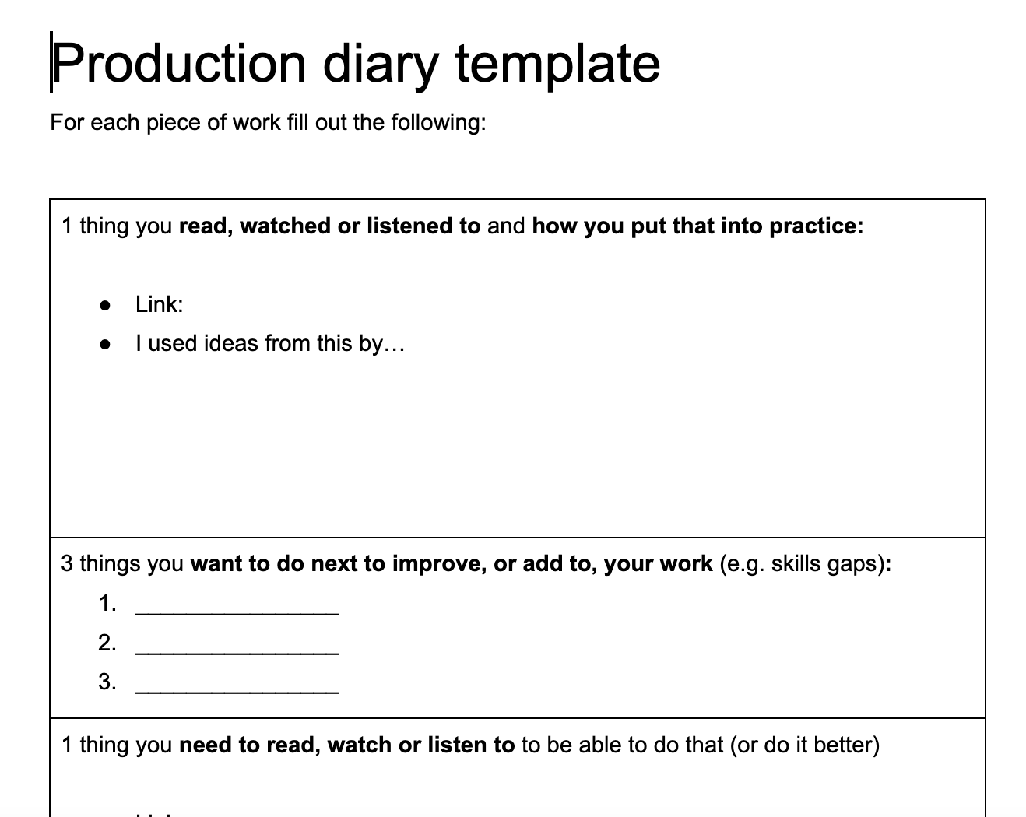
https://docs.google.com/document/d/e/2PACX-1vTgAV8UbPH2dihelbnYNN5e3UetreWwYMQPuJd50RFCEx_xCZSoP4Em_e0uhPH7L68cWB6PK6dqk6e5/pub

Slide 5
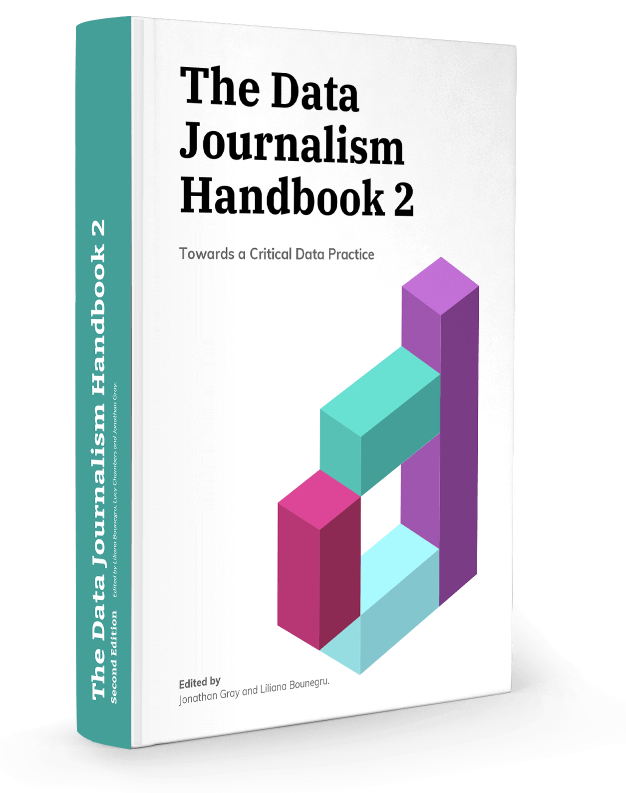
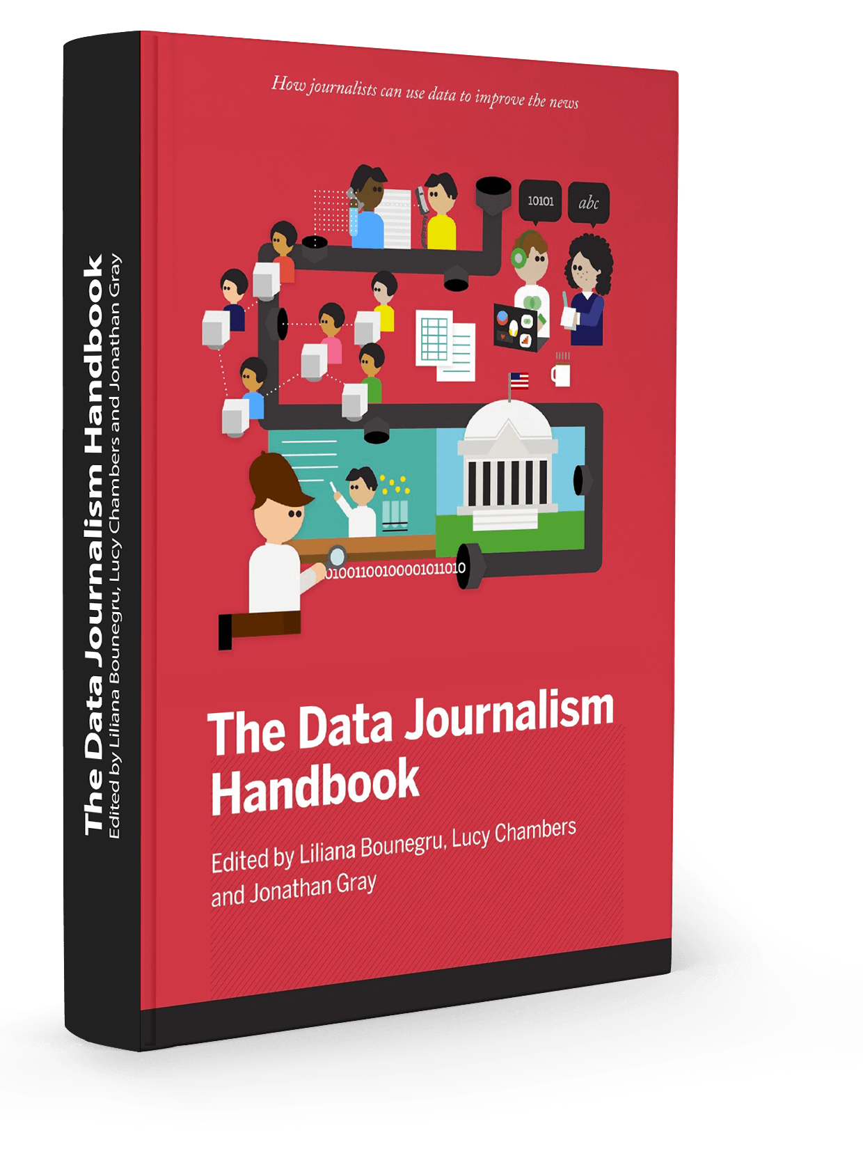
https://datajournalism.com/read/handbook/two/
https://datajournalism.com/read/handbook/one/

Slide 6
In teams:
Pick a different chapter each
Read it — no distractions (close tabs, alerts off, etc.)
Make notes about things you can put into your own work
Ask questions where anything isn’t clear
Summarise your chapter for the others (take turns), focusing on ideas it’s given you, or practical steps you might include in your own project

Slide 7
Pick a chapter
(5 mins)
Look for descriptions that sound useful. Scan the chapter - change if it’s not what you want.

Slide 8
Read — making notes
(30 mins)
Useful tips
Ideas that it inspires
Ask questions if needed

Slide 9
Share
(10-20 mins+)
Useful tips
Ideas that it inspires
Rest of the group: make notes!

Slide 10
Complete a diary
(5-10 mins)
Link + ideas
3 things you want to do next
1 thing you need to read for that

Slide 11
Start your evaluation
Start a blank document, type Critical Evaluation at the top
Write a line about what you learned from the reading, then end it with the reference.
That reference will look like this: (SURNAME, 2019)
Replace SURNAME with the actual surname of the author

Slide 12
Start your bibliography
Type Bibliography after your evaluation
Your first reference will look like this: SURNAME, FIRST NAME (2019) CHAPTER TITLE. In Jonathan Gray, Liliana Bounegru, Lucy Chambers. Data Journalism Handbook 2. O'Reilly Media

Slide 13
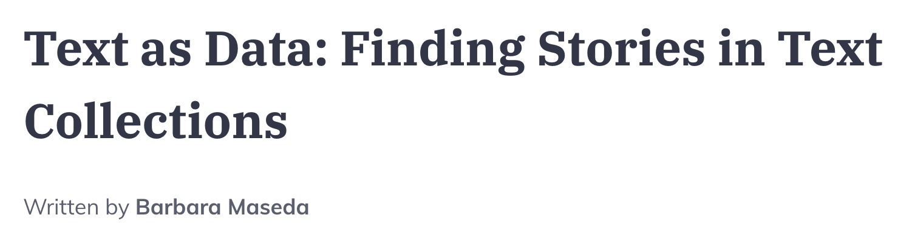
Example:
Critical evaluation
You can get data stories from text by measuring length, the most common words mentioned, or change over time (Maseda 2019)
Bibliography
Maseda, Barbara (2019) Text as Data: Finding Stories in Text Collections. In Jonathan Gray, Liliana Bounegru, Lucy Chambers. Data Journalism Handbook 2. O'Reilly Media

Slide 14
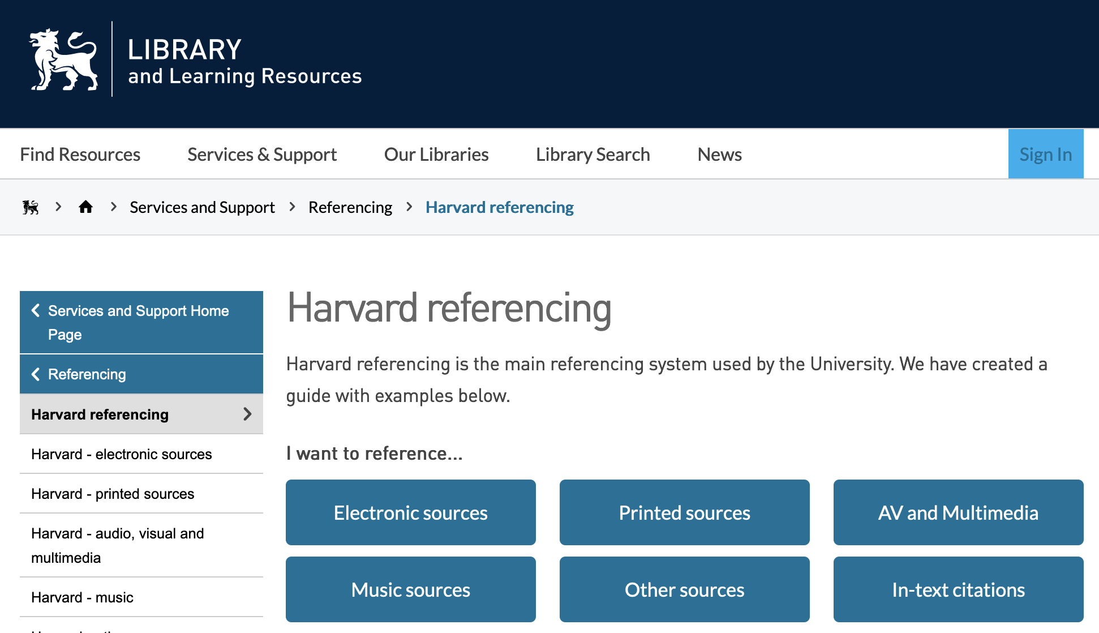
If in doubt:
https://www.bcu.ac.uk/library/services-and-support/referencing/harvard

Slide 15
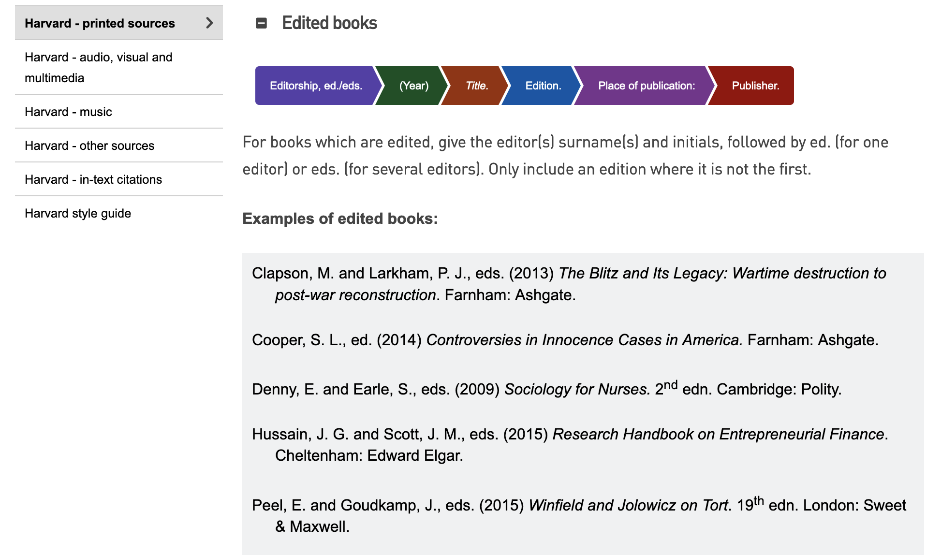
https://www.bcu.ac.uk/library/services-and-support/referencing/harvard/printed-sources

Slide 16
Directed study to do before next week:
Read another chapter
Read some data journalism (see #ddj on Twitter and newsletters)
Brainstorm at least 10 story ideas that could involve data
Be prepared to pitch them next week

Slide 17
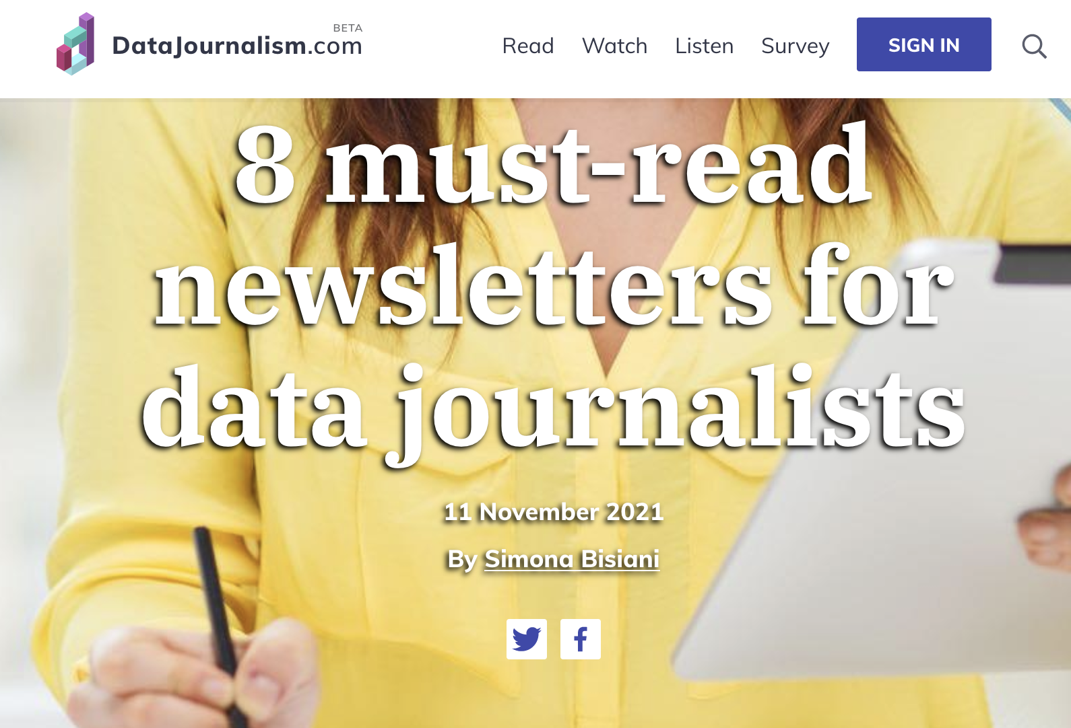
datajournalism.com/read/blog/data-journalism-newsletters

